Slide 1
CS 585 - Section I01 Software Engineering University Social Media Platform
By:
Divya Sonita Thirumalareddy
Narendra Reddy Maram
Naveen Kumar Akula
Bhuvaneswari Sayapaneni

Slide 2
Abstract: University social media platform
We wanted to build this application because there is a need for students at the university to know each other for better communication. This application is for students to see the posts from other students/ Faculty or by University and every student can keep a track of all the events which is going on in the university since everything will be posted in their timeline. For that to happen, the basic thing is to create a registration module for all students to register and then login into their profiles. Students can message other students individually or by creating groups. You can add or delete people from your account as per your requirement.

Slide 3
Links for the Scrum meetings:
https://drive.google.com/file/d/1FaPXxk4Z4tniGlF8NRyHPWlkhRSrlHOA/view?usp=sharing
https://drive.google.com/file/d/1H-jZsR1e9AHvVu2FhSCFccgzqW5SYBAj/view?usp=drivesdk

Slide 4
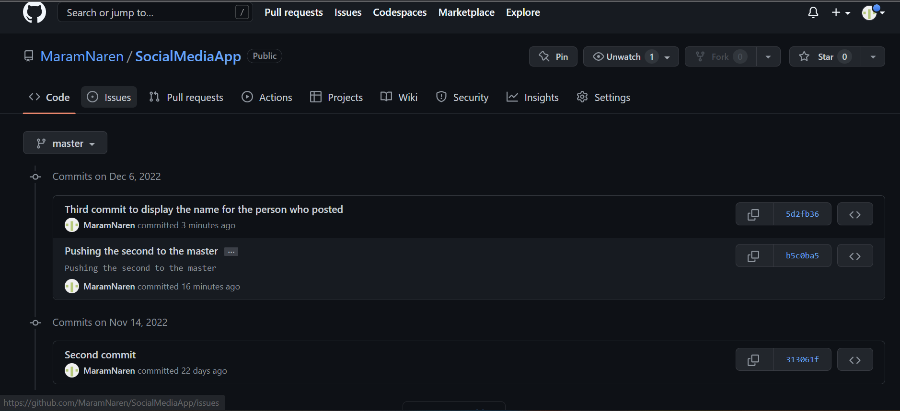
Code pushed into GitHub: https://github.com/MaramNaren/SocialMediaApp
Multiple commits to GitHub made below is the screenshot.

Slide 5

Application
We have developed the below features.
Registration page
Login Page
Timeline
Communities →Add Friends/Remove Friends
Update Profile picture
Logout

Slide 6
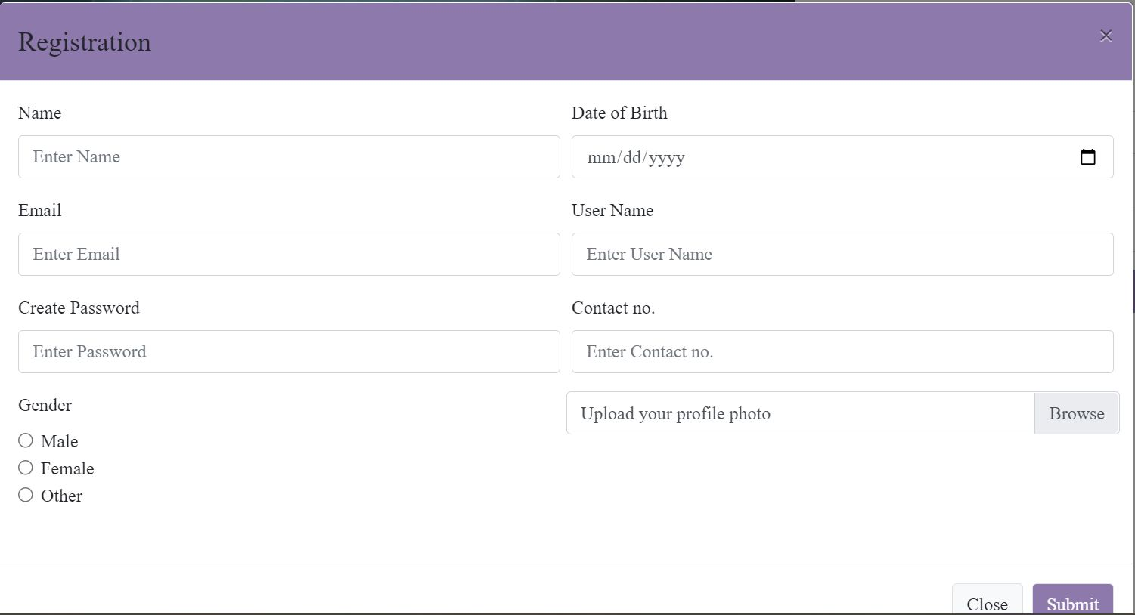
Registration page
Every user must register to our application to order to use the Application

Slide 7
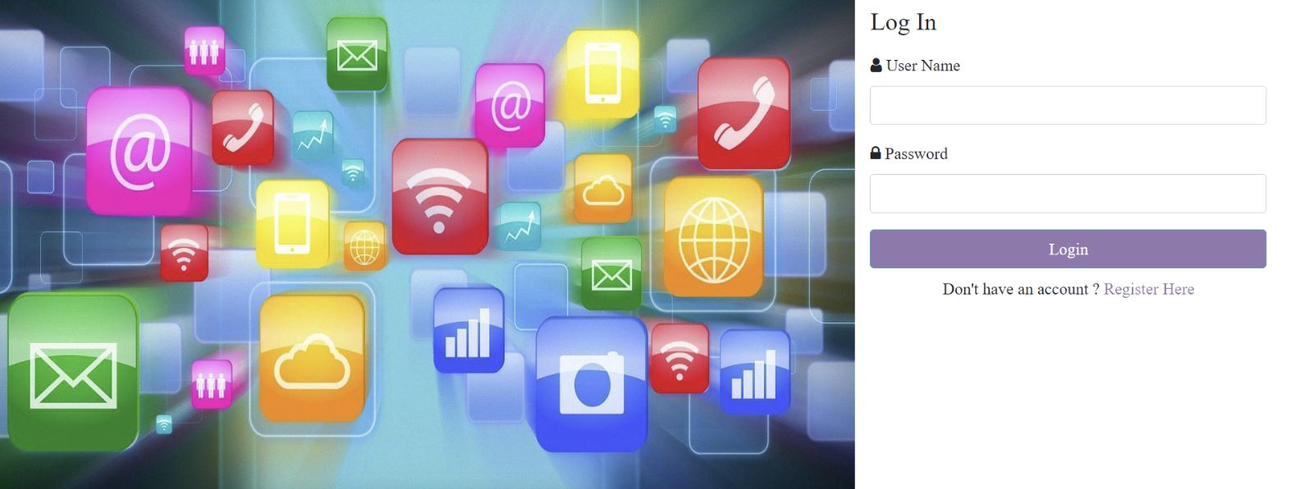
Login page
Once user is done with registration then the user can login to our application with username and password

Slide 8
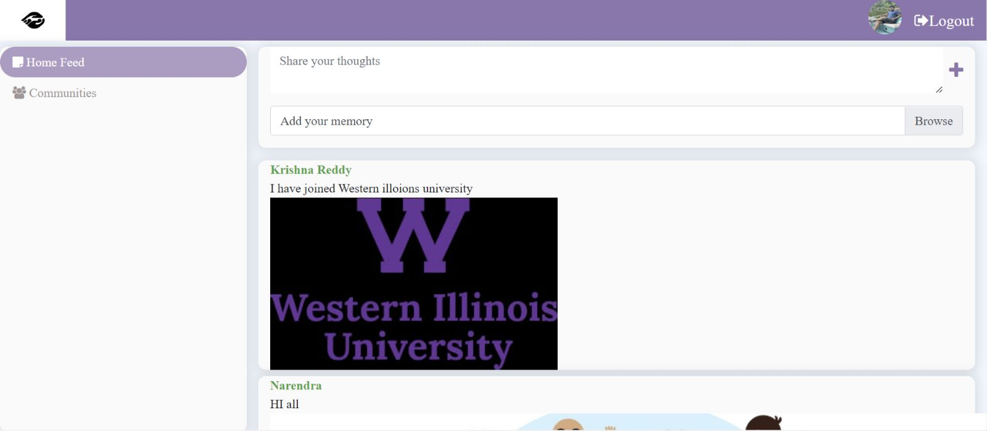
Timeline
on this users can all the posts that are posted.

Slide 9
Communities
On this page users can see each other profiles and they can Add friends/Remove Friends as per the wish

Slide 10
Divya Sonita
Developed the feature view timeline with the content posted by
member's feature.
Designed the database architecture of the project.
Completed the database data saving of the project.

Slide 11
Naveen Kumar Akula
Design of the student’s login page with CSS.
Developed the login/registration validation process.
Design and development of the Add/Remove friend’s feature.

Slide 12
Narendra Reddy Maram
I have completed finalizing the project’s database architecture and done code push database requirements.
Completed the project setup.
Developed the student registration page.
Design and development of posting status update on social media features.
I have handled the code to GitHub.
https://github.com/MaramNaren/SocialMediaApp

Slide 13
Bhuvaneswari Sayapaneni
After user stories are created, I started preparing the Testcase scenarios.
I have created all possible scenarios to test in the application developed so far.
Design and development of the view and update own details.
Done with the development of the view members feature of the project.
Planned all the testing activities and collaborated with team for testing.

